Slide 1
第四节：GLM4开源模型分解
2024.8.8

Slide 2
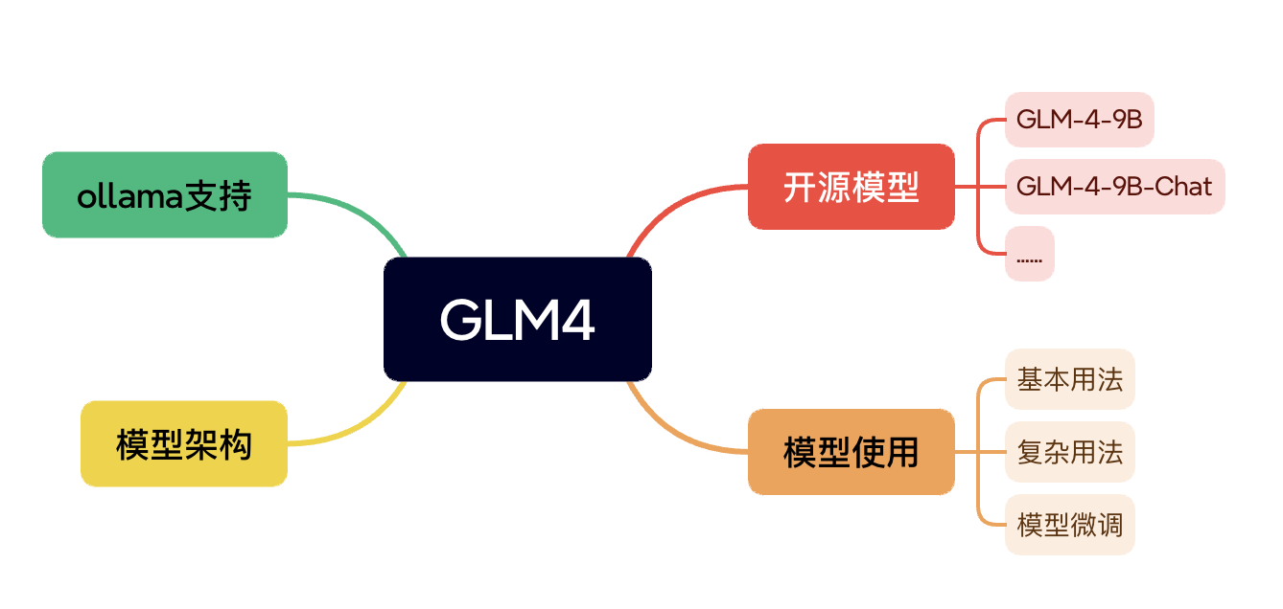
GLM4相关工具链

Slide 3
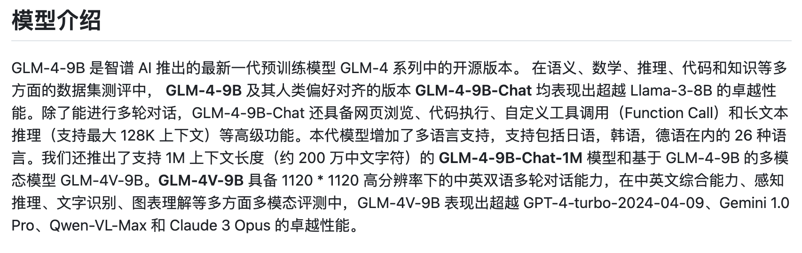
GLM4开源模型特性
https://github.com/THUDM/GLM-4

Slide 5
GLM4几种用法
huggingface transformers
https://huggingface.co/docs/transformers/v4.44.0/zh/index
huggingface github
https://github.com/huggingface

Slide 6
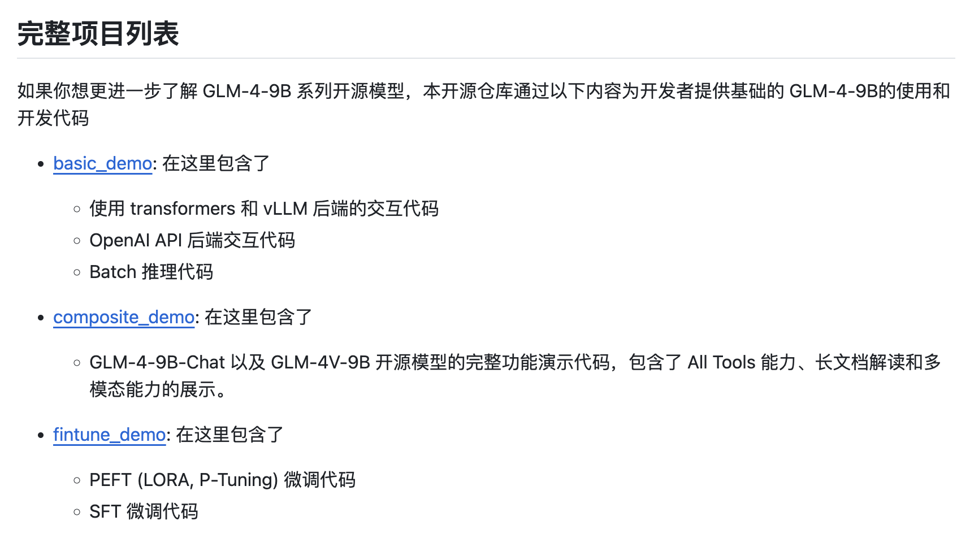
GLM4几种用法

Slide 8
GLM4模型架构
huggingface GLM-4
https://huggingface.co/THUDM/glm-4-9b-chat/tree/main

Slide 10
GLM4与Ollama
Ollama
https://ollama.com/
ollama-python
https://github.com/ollama/ollama-python
ollama-GLM4
https://ollama.com/library/glm4

Slide 11
THANK YOU

